Slide 1

Real-Time Data Quality Assessment and Query Interface Parul Verma Nikhil Sethi

Slide 2
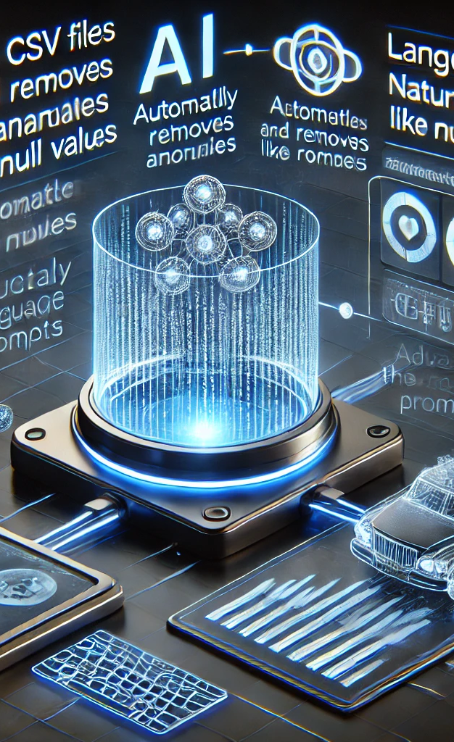
Problem Statement
This project focuses on building a robust AI-based system that takes structured data (CSV files) as input, automatically detects and removes anomalies (e.g., null values), and allows users to query the cleaned data using natural language prompts. The system will integrate LangChain API to leverage the power of GPT-3.5 for querying and providing meaningful insights from the data.

Slide 3
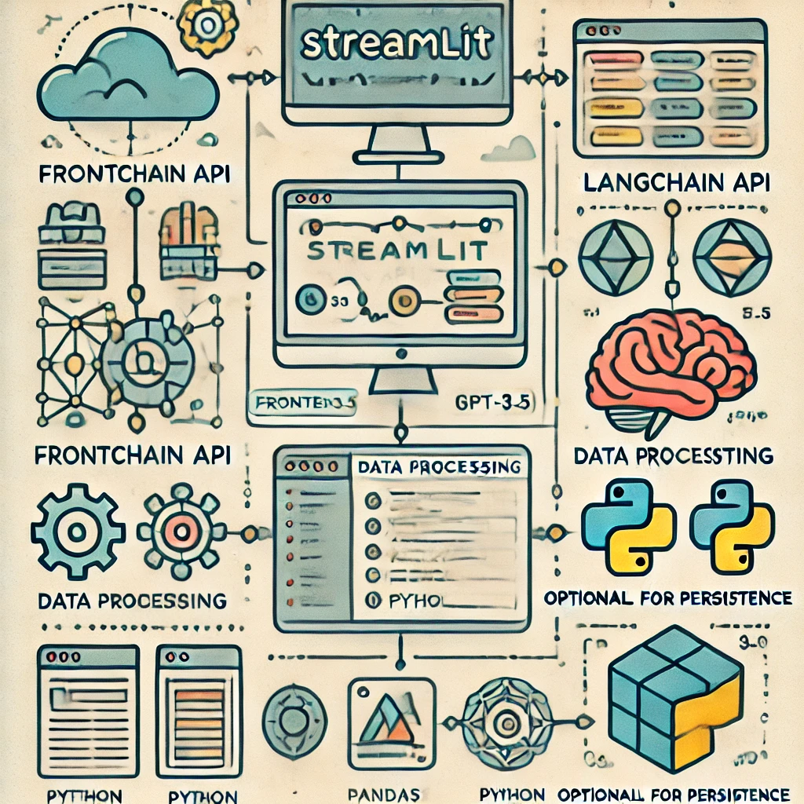
Technical Overview
Frontend: Streamlit
Backend:
LangChain API for prompt handling.
GPT-3.5 for natural language understanding and querying.
Python for data processing (using Pandas for CSVfile handling).
Data Cleaning Libraries: Pandas or custom scripts for detecting and removing anomalies.

Slide 4
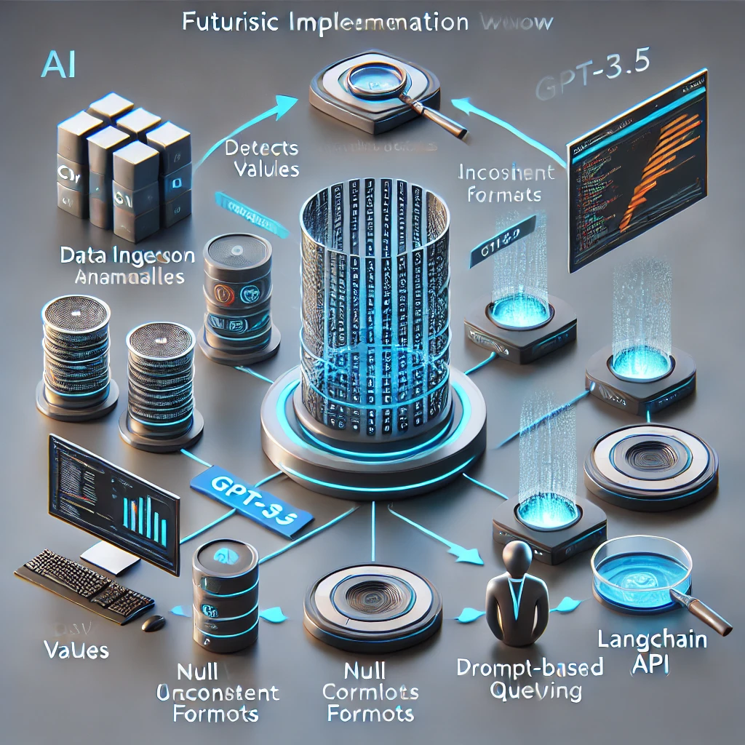
Work Flow
Data Ingestion: Ability to input CSV Filee
Anomaly Detection and Cleaning: The system will automatically detect missing or erroneous data and remove or rectify anomalies such as:
Null values
Inconsistent formats
Outliers (optional for numeric data)
Prompt-based Querying: Users will interact with the cleaned data using natural language queries, powered by GPT-3.5 via the LangChain API..
4. Conversational Querying: Enable follow-up questions, contextual understanding, and complex queries to generate valuable insights.

Slide 5
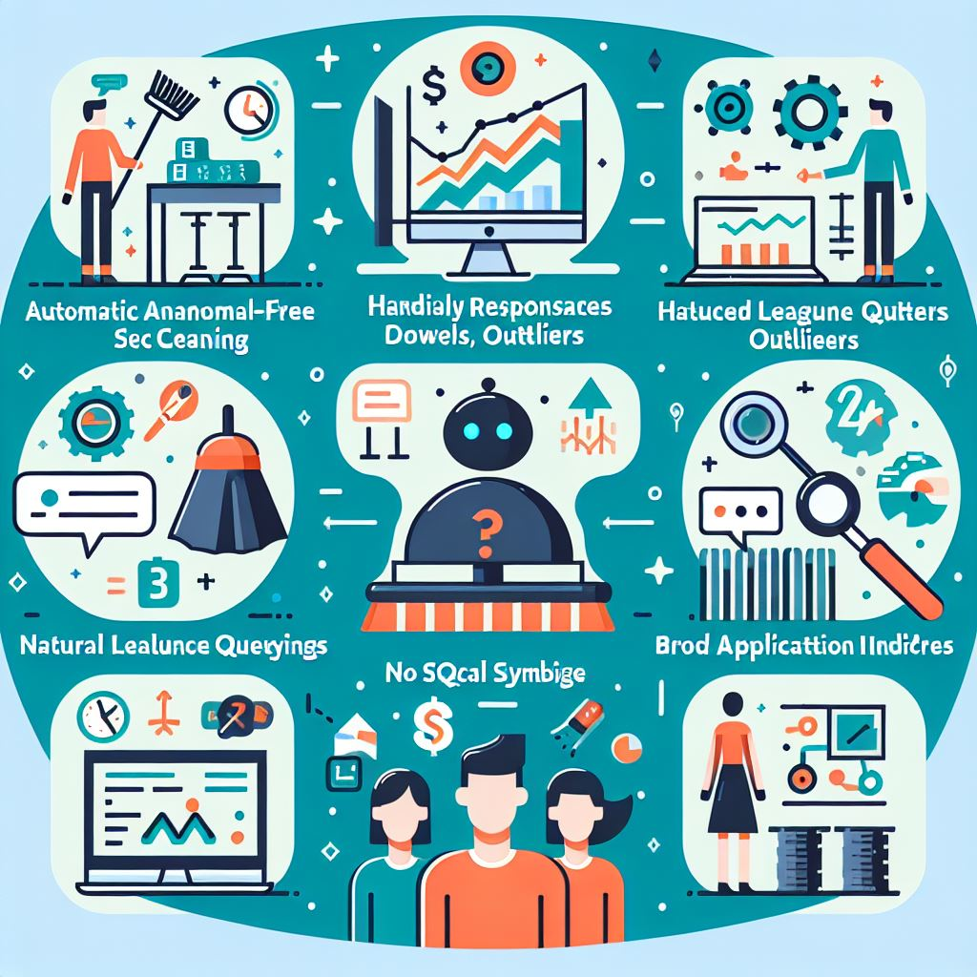
Results and Expected Impact
Demonstrated Results (or Expected Results):
Anomaly-free datasets, cleaned automatically (handling null values, outliers, etc.)
Accurate and relevant responses to natural language queries using GPT-3.5
Simple, user-friendly querying without the need for technical knowledge like SQL
Potential Impact:
Increased Accessibility: Enables non-technical users to interact with data effortlessly through prompts
Faster Insights: Reduces time spent on manual data cleaning and SQL writing, providing faster access to critical insights
Broader Application: Applicable across industries (e.g., finance, retail, healthcare) where non-technical staff need data analysis capabilities

Slide 6

Future Enhancement
Advanced Anomaly Detection:
Implement more sophisticated methods for detecting outliers and anomalies beyond null handling.
Multi-turn Conversations:
Enable more complex, multi-step queries for deeper insights and context-aware interactions.
Real-time Data Support:
Expand the system to handle streaming data or real-time data sources for dynamic querying.
User-friendly UI/UX:
Develop a user-friendly interface to broaden accessibility, making the system easy to use for all.
Database Integration:
Integrate with databases for persistent storage and querying, allowing for larger datasets and continuous updates.

Slide 7
Thank you
Parul Verma (M22AI1008)
Nikhil Sethi (M22AI1006)

